Slide 1

Machine Learning With Python & R
by Rishi Bansal

Slide 2
Machine Learning ?

Slide 3
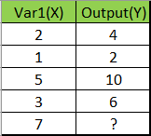
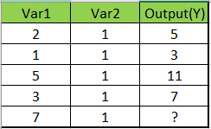
Puzzle
y = 2x
y = 2*(var1) + (var2)

Slide 4
What is AI , Machine Learning, Deep Learning and Data Science?
AI : Artificial intelligence is a very wide term with applications ranging from robotics to text analysis. It is still a technology under evolution.
Machine Learning: Machine learning is a subset of AI that focuses on a narrow range of activities. It is, in fact, the only real artificial intelligence with some applications in real-world problems.
Data Science:
It uses ML to analyze data and make predictions about the future.
Not a subset of ML.
It combines machine learning with other disciplines like big data analytics and cloud computing.

Slide 5
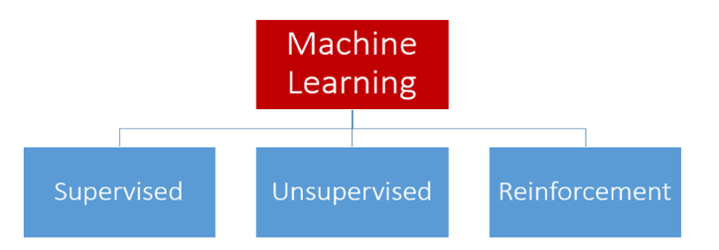
Types of Machine Learning
Models:
Supervised - labeled data is used to help machines recognize characteristics and use them for future data. E.g: classify pictures of cats and dogs.
Unsupervised - we simply put unlabeled data and let machine understand the characteristics and classify it. E.g: Clustering (News Article)
Reinforcement Learning: RML interact with the environment by producing actions and then analyze errors or rewards. E.g: Chess game

Slide 6
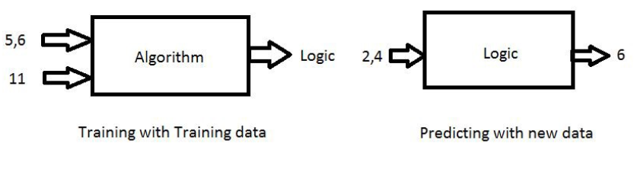
Supervised Learning
Training Data – Data as input
The training data includes both Inputs and Labels(Targets)
Here addition of two numbers a=5,b=6 result =11, Inputs are 5,6 and Target is 11
We don’t get exact 6 as answer we may get value which is close to 6 based on training data and algorithm

Slide 7
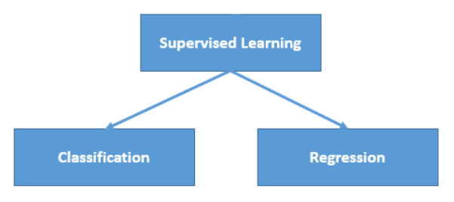
Types of Supervised Learning
Regression: This is a type of problem where we need to predict the continuous-response value (ex : above we predict number which can vary from -infinity to +infinity)
E.g: House Price, Value of stock
Classification: This is a type of problem where we predict the categorical response value where the data can be separated into specific “classes” (ex: we predict one of the values in a set of values).
E.g: Mail spam or not, Diabetes or not, etc

Slide 8
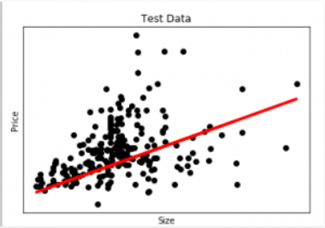
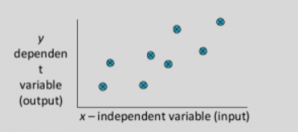
Regression
A regression problem is when the output variable is a real or continuous value, such as “salary” or “weight”. Many different models can be used, the simplest is the linear regression. It tries to fit data with the best hyper-plane which goes through the points

Slide 9
Reading Assignment
Mean, Median, Mode, Variance, Covariance
Sum of Square Errors, Least Squares
Fit and Coefficient of Determination
Standardized Regression
Estimate Coefficients
Confidence Bands
Prediction Interval Bands
Residual Analysis

Slide 10
Classification
A classification problem is when the output variable is a category, such as “red” or “blue” or “disease” and “no disease”. A classification model attempts to draw some conclusion from observed values. Given one or more inputs a classification model will try to predict the value of one or more outcomes.
Classification models include logistic regression, decision tree, random forest, gradient-boosted tree, multilayer perceptron, one-vs-rest, and Naive Bayes.

Slide 11
Question 1
Which of the following is a regression task?
Predicting age of a person
Predicting nationality of a person
Predicting whether stock price of a company will increase tomorrow
Predicting whether a document is related to sighting of UFOs?

Slide 12
Question 2
Which of the following is/are classification problem(s)?
Predicting the gender of a person by his/her handwriting style
Predicting house price based on area
Predicting whether monsoon will be normal next year
Predict the number of copies a music album will be sold next month

